Slide 1

Machine Learning (Naïve Bayes, Bayesian Learning)

Slide 2
Introduction
What is MACHINE LEARNING?
Machine learning is a branch of artificial intelligence (AI) and computer science which focuses on the use of data and algorithms to imitate the way that humans learn, gradually improving its accuracy.
Machine learning is an important component of the growing field of data science. Through the use of statistical methods, algorithms are trained to make classifications or predictions, uncovering key insights within data mining projects. These insights subsequently drive decision making within applications and businesses, ideally impacting key growth metrics

Slide 3
Naïve Bayes, Bayesian Learning
What is Naïve Bayes?
Naïve Bayes is a simple learning algorithm that utilizes Bayes rule together with a strong assumption that the attributes are conditionally independent, given the class. While this independence assumption is often violated in practice, naïve Bayes nonetheless often delivers competitive classification accuracy.
What is Bayesian Learning?
The Bayesian framework for machine learning states that you start out by enumerating all reasonable models of the data and assigning your prior belief P(M) to each of these models. Then, upon observing the data D, you evaluate how probable the data was under each of these models to compute P(D|M).

Slide 4

Bayes Theorem
Bayes Theorem:- It is a theorem that works on conditional probability. Conditional probability is the probability that something will happen, given that something else has already occurred. The conditional probability can give us the probability of an event using its prior knowledge.
Conditional probability :-
Where,
P(A): The probability of hypothesis H being true. This is known as the prior probability.
P(B): The probability of the evidence.
P(A|B): The probability of the evidence given that hypothesis is true.
P(B|A): The probability of the hypothesis given that the evidence is true.

Slide 5
Mathematics Behind Naive Bayes
Let’s better understand this with the help of a simple example :- Consider a well-shuffled deck of playing cards. A card is picked from that deck at random. The objective is to find the probability of a King card, given that the card picked is red in color.
Here, P(King | Red Card) = ?
We’ll use, P(King | Red Card) = P(Red Card | King) x P(King) / P(Red Card)
So, P (Red Card | King) = Probability of getting a Red card given that the card chosen is King = 2 Red Kings / 4 Total Kings = ½
P (King) = Probability that the chosen card is a King = 4 Kings / 52 Total Cards = 1 / 13
(Red Card) = Probability that the chosen card is red = 26 Red cards / 52 Total Cards = 1/ 2
Hence, finding the posterior probability of randomly choosing a King given a Red card is:
P (King | Red Card) = (1 / 2) x (1 / 13) / (1 / 2) = 1 / 13 or 0.077

Slide 6
Understanding Naive Bayes with an Example
To predict the weather based on three predictors: humidity, temperature and wind speed. The training data is the following:
Humidity | Temperature | Wind Speed | Weather
Humid | Hot | Fast | Sunny
Humid | Hot | Fast | Sunny
Humid | Hot | Slow | Sunny
Not Humid | Cold | Fast | Sunny
Not Humid | Hot | Slow | Rainy
Not Humid | Cold | Fast | Rainy
Humid | Hot | Slow | Rainy
Humid | Cold | Slow | Rainy

Slide 7
We’ll use naive Bayes to predict the weather for the following test observation:
Humidity % | Temperature (C) | Wind Speed (Km/h) | Weather
Humid | Cold | Fast | ?
We have to determine which posterior is greater, sunny or rainy. For the classification Sunny, the posterior is given by:
Posterior( Sunny) = (P(Sunny) x P(Humid / Sunny) x P(Cold / Sunny) x P(Fast / Sunny)) / evidence
Similarly, for the classification Rainy, the posterior is given by:
Posterior( Rainy) = (P(Rainy) x P(Humid / Rainy) x P(Cold / Rainy) x P(Fast / Rainy)) / evidence
Where,
evidence = [ P(Sunny) x p(Humid / Sunny) x p(Cold / Sunny) x P(Fast / Sunny) ] + [ (P(Rainy) x P(Humid / Rainy) x P(Cold / Rainy) x P(Fast / Rainy) ) ]
Here,
P(Sunny) = 0.5
P(Rainy) = 0.5
P(Humid/ Sunny) = 0.75
P(Cold/ Sunny) = 0.25
P(Fast/ Sunny) = 0.75
P(Humid/ Rainy) = 0.25
P(Cold/ Rainy) = 0.75
P(Fast/ Rainy) = 0.25
Therefore, evidence = 0.703 + 0.023 = 0.726.
Posterior (Sunny) = 0.0968
Posterior (Rainy) = 0.032
Since the posterior numerator is greater in the Sunny case, we predict the sample is Sunny.

Slide 8
Naive Bayes Classifier
Working of Naïve Bayes’ Classifier can be understood with the help of the below example:
Suppose we have a dataset of weather conditions and corresponding target variable "Play". So using this dataset we need to decide that whether we should play or not on a particular day according to the weather conditions. So to solve this problem, we need to follow the below steps:
Convert the given dataset into frequency tables.
Generate Likelihood table by finding the probabilities of given features.
Now, use Bayes theorem to calculate the posterior probability.

Slide 9
Naive Bayes Classifier
It is a kind of classifier that works on the Bayes theorem. Prediction of membership probabilities is made for every class such as the probability of data points associated with a particular class.
The class having maximum probability is appraised as the most suitable class. This is also referred to as Maximum A Posteriori (MAP).
The MAP for a hypothesis is:
𝑀𝐴𝑃 (𝐻) = max 𝑃((𝐻|𝐸))
𝑀𝐴𝑃 (𝐻) = max 𝑃((𝐻|𝐸) ∗ (𝑃(𝐻)) /𝑃(𝐸))
𝑀𝐴𝑃 (𝐻) = max(𝑃(𝐸|𝐻) ∗ 𝑃(𝐻))
𝑃 (𝐸) is evidence probability, and it is used to normalize the result. The result will not be affected by removing 𝑃(𝐸).

Slide 10
Types Of Naive Bayes Algorithms
1. Gaussian Naïve Bayes: When characteristic values are continuous in nature then an assumption is made that the values linked with each class are dispersed according to Gaussian that is Normal Distribution.
2. Multinomial Naïve Bayes: Multinomial Naive Bayes is favored to use on data that is multinomial distributed. It is widely used in text classification in NLP. Each event in text classification constitutes the presence of a word in a document.
3. Bernoulli Naïve Bayes: When data is dispensed according to the multivariate Bernoulli distributions then Bernoulli Naive Bayes is used. That means there exist multiple features but each one is assumed to contain a binary value. So, it requires features to be binary-valued.

Slide 11
Advantages And Disadvantages Of Naive Bayes Classifier
Advantages:
It is a highly extensible algorithm that is very fast.
It can be used for both binaries as well as multiclass classification.
It has mainly three different types of algorithms that are GaussianNB, MultinomialNB, BernoulliNB.
It is a famous algorithm for spam email classification.
It can be easily trained on small datasets and can be used for large volumes of data as well.
Disadvantages:
The main disadvantage of the NB is considering all the variables independent that contributes to the probability.

Slide 12
Applications of Naive Bayes Algorithms
Real-time Prediction: Being a fast learning algorithm can be used to make predictions in real-time as well.
Multiclass Classification: It can be used for multi-class classification problems also.
Text Classification: As it has shown good results in predicting multi-class classification so it has more success rates compared to all other algorithms. As a result, it is majorly used in sentiment analysis & spam detection.
It is used for Credit Scoring.
It is used in medical data classification.
It can be used in real-time predictions because Naïve Bayes Classifier is an eager learner.
It is used in Text classification such as Spam filtering and Sentiment analysis.

Slide 13
Roles for Bayesian Methods
1. Provides practical learning algorithms
Naive Bayes learning
Bayesian belief network learning
Combine prior knowledge (prior probabilities) with observed data
Requires prior probabilities
2. Provides useful conceptual framework
Provides “gold standard” for evaluating other learning algorithms
Additional insight into Occam’s razor

Slide 14
Research Paper Review
Problem statement of research paper :- Investigating the Performance of Naïve- Bayes Classifiers and K- Nearest Neighbor Classifiers.
The main objective of this paper is to review, implement Bayesian theory and investigating the performance of two widely used Naive Bayes and K- Nearest Neighbor (KNN) classifier based on an application "Credit card approval", and also to show how classification rate improves in KNN by varying the value of k. The proposed approach is implemented and applied, the experimental results and performance evaluation are shown and finally conclusions are discussed.

Slide 15

ML model implementation
In the general case, they have k mutually exclusive and exhaustive classes; hi , i = 1, ......k; P(D|hi) is the probability of seeing D as the input when it is known to belong to class hi . The posterior probability of class hi can be calculated as-
In order to choose the best hypotheses from amongst the set of generated hypothesis the maximally probable hypothesis hMAP is selected and is known as maximum a posteriori (MAP) hypothesis and if we assume that P(h) is same for all the hypothesis then the maximally probable hypothesis reduces to maximum likelihood hypothesis.

Slide 16

Naïve Bayes Classifier
The Naive Bayes classifier is based on the simplifying assumption that the attribute values are conditionally independent given target value. In other words, the assumption is that given the target value of the instance, the probability of observing the conjunction a1, a2......an is just the product of the probabilities for the individual attributes:
So, basically the Naive Bayes Classifier ignores the possible dependencies, namely, correlations, among the inputs and reduces a multivariate problem to a group of univariate problems. It is noticed that in a Naive Bayes classifier the number of distinct P( ai|aj)terms that must be estimated from the training data is just the number of distinct attribute values times the number of distinct target values- a much smaller number than if we were estimate the P(a1, a2, ……………… an|vj) terms as needed for Bayesian theory.

Slide 17
K-Nearest Neighbour Classifier (KNN)
Among the various methods of supervised statistical pattern recognition, the Nearest Neighbor rule achieves consistently high performance, without a priori assumptions about the distributions from which the training examples are drawn. It involves a training set of both positive and negative cases. A new sample is classified by calculating the distance to the nearest training case; the sign of that point then determines the classification of the sample. The k-NN classifier extends this idea by taking the k nearest points and assigning the sign of the majority. It is common to select k small and odd to break ties (typically 1, 3 or 5). Larger k values help reduce the effects of noisy points within the training data set, and the choice of k is often performed through cross-validation.
In parametric methods, whether for density estimation or classification, we assume a model valid for over the whole input space. In classification, when we assume a normal density, we assume that all examples of the class are drawn from this same density. But practically this assumption does not always hold and we may incur a large error if it does not. If we cannot make such assumptions and cannot come up with a parametric model, one possibility is to use semi parametric mixture model. In nonparametric estimation, all we assume is that similar inputs have similar outputs. This is a reasonable assumption: The world is smooth and functions, whether they are densities, discriminants or regression functions, changes slowly. Similar instance means similar things. Therefore, our algorithm is composed of finding the similar past instances from the training set using a suitable distance measure and interpolating from them to find the right output.

Slide 18
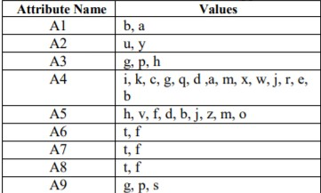
Implementation, Training and Testing
In this section the classifier implemented, trained using the training set and then testing the classifier using the other set for testing. The data set is collected for this application from the source.
The brief description of the data file is given below:
• Raw datafile: crx raw.data
• Training datafile: crx.train
• Testing datafile: crx.test
Story behind the data file: These files concern credit card applications. All attribute names and values have been changed to meaningless symbols to protect confidentiality of the data. This dataset is interesting because there is a good mix of attributes – continuous, nominal with small numbers of values, and nominal with larger numbers of values. There are also a few missing values.
Attributes for Credit Card application

Slide 19
Simulation Results and Performance Analysis
Using Naive Bayes classifier at first the tables are constructed from the attributes A1 to A9. The test set is classified based on the probabilities estimated. Each example is picked up from the test set and then its class is predicted. The predicted class is compared with target value that is given in test set. If they mismatch, this example becomes error. The same process is repeated for all 201 examples and last of all the percentage of correct classification and misclassification is calculated. Intuitively the trained classifier is tested on training set by which it is trained and surprisingly the information found is also not error free. It has some percentage of misclassification which is close to the value that is found is testing set. The information on training set found.
In K- Nearest Neighbor, the value of k is given like k=1, 3, 5, 11, 51, and 101. The distance metric is also given which is called Euclidean distance. Initially all 470 training examples are stored in a look up training set. The dimension of the distance vector is 470x1. Based on the value of k, the k numbers of smallest distance training examples are picked up and then calculate their corresponding accept or reject. Since k is always odd, so there is no chance to tie. For example, for k=1, the minimum distance training examples output will be the predicted value for this testing examples. For k=3, 3 minimum distance training examples output are considered and calculate the number of accept and reject. The bigger one will be the predicted value for this testing example. The same procedure is repeated for k=5, 11, 51 and 100. Last of all for each k, the (%) or error is calculated.
It is clear that for this particular problem at K=5, we get the minimum error which is 9.45(%)

Slide 20


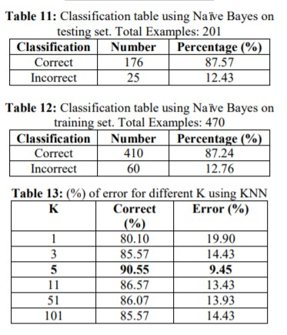
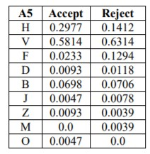

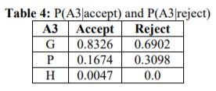
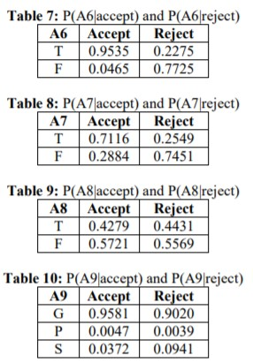
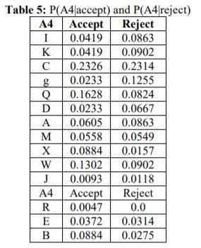
List of Tables

Slide 21
Hyper parameter tuning to improve performance of ML Model.
Bayesian Optimisation :-
Bayesian Optimisation has emerged as an efficient tool for hyperparameter tuning of machine learning algorithms, more specifically, for complex models like deep neural networks. It offers an efficient framework for optimising the highly expensive black-box functions without knowing its form. It has been applied in several fields including learning optimal robot mechanics, sequential experimental design, and synthetic gene design.

Slide 22
Results of the research paper
The main objective of this paper was to review the Bayesian theory and explore two simple machine learning techniques: a Naive Bayes classifier and KNearest Neighbor Classifier and investigate the performance of these two widely used classifiers.
1. The result of Bayesian inference depends strongly on prior probabilities, which must be available in order to apply the method directly. Since the Bayes theorem provides a principled way to calculate the posterior probability of each hypothesis given the training data, we can use it as the basis for straightforward learning algorithm that calculates the probability for each hypothesis then outputs the most probable.
2. The Naive Bayes classifier is applied to the credit card approval testing data set and found 12.43 (%) error of misclassification.
3. Instance-based methods are sometimes referred to as “Lazy” learning methods, because they delay the process until a new instance must be classified. A key advantage of this kind of delayed or lazy learning is that instead of estimating the target function once for the entire space, these methods can estimate it locally and differently for each new instance to be classified.
4. In K-Nearest Neighbor method, the selection of k values is tricky and application dependent. To simplify our problem it is always fixed to odd number so that no tie can happen. In our experiment we tried to classify the credit approval testing data set for different values of k and for k=5 they got the maximum correct classification rate. In that value the (%) of error classification is around 9.45 (%).

Slide 23
Conclusion : Naïve Bayes, Bayesian Learning
Bayesian Learning :-
Probabilistic inference lends power and flexibility, can incorporate prior probabilistic knowledge.
Can make statistically invalid assumptions and still get reasonably good results (Naive Bayes).
Provides insights into algorithms that don’t even use probabilities (explicitly).
Bayesian Belief Networks let us incorporate even more types of prior knowledge (than standard Bayes techniques).
Many techniques that have proven their success in many application areas.
Naive Bayes :- Naive Bayes algorithms are widely deployed for sentiment analysis, spam filtering, recommendation systems etc. They are fast and easier to employ but have the biggest disadvantage “the requirement of predictors to be independent”.

